Slide 1
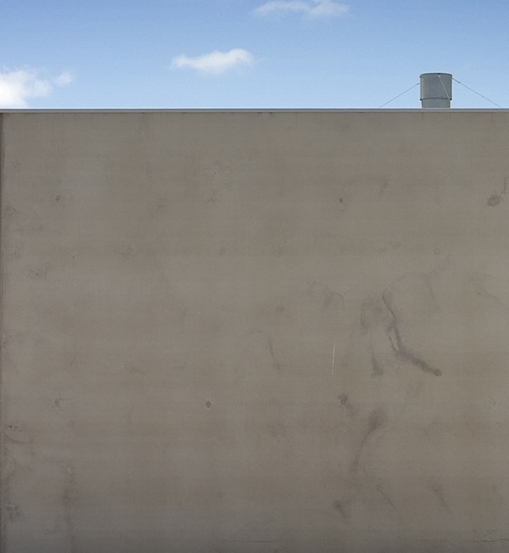



creative block by luke roberts, licensed under a
Creative Commons Attribution Non-Commercial ShareAlike licence 2.0,
http://flickr.com/photos/lukeroberts/292148887/in/pool-ccsalon
DocAgora@AIDC
27 february 2007
getting it out there
digital technologies + copyright management as tools for filmmakers
elliott bledsoe
project officer
creative commons australia
“some rights reserved”
this presentation is licensed under a Creative Commons Attribution 2.5 Australia licence,
full terms @ http://creativecommons.org/licenses/by/2.5/au/
copyright on other content included in this presentation is noted accordingly
the ccClinic and ccResearch projects are funded by the ARC Centre of Excellence for Creative Industries and Innovation
www.cci.edu.au
Notes:
Hello everyone, I am Elliott Bledsoe and I am a Project Officer with Creative Commons Australia. CCau is an Open Content Licensing research project funded by the Australian Research Council Centre of Excellence for Creative Industries and Innovation.
Before I begin, so you are aware this presentation is licensed under a Creative Commons Attribution 2.5 Australia licence, meaning you are free to reuse it however you like, so long as you acknowledge me as the original presenter.
DocAgora have asked me hear to talk to you about alternative distribution and funding models for documentary film. In particular, I will be detailing the growing trend towards Open Content Licensing, and particularly Creative Commons licences, as a way of managing copyright in the digital environment.
But let’s start by contextualising copyright in the digital environment

Slide 2

Notes:
Hands up if you haven’t seen this logo.
With the digital-piracy hype these days, it would be difficult to find someone who hasn’t.

Slide 3
copyright
copyright is a balancing act.
creator’s exclusive rights
vs
public access
Notes:
The rationale of copyright is to encourage innovation and creativity by vesting in the creator exclusive rights to the content while still permitting public access to that content.

Slide 4
copyright
original expression, not ideas
comes into existence upon creation
protects:
  literary, dramatic, musical + artistic works; and
  “other subject matter”: including films, sound recordings, broadcasts + published editions
does not require registration or notification
exists for the life of the creator + 70 years
source of copyright: Copyright Act 1968
Notes:
Most people have an idea what the circle c logo means, but don’t know the specifics of it? Quickly, the key things to know about current copyright are:
copyright protects original expression, not the idea behind it
it comes into existence automatically upon creation of a work, whether that be literary, dramatic, musical or artistic works, or what is termed “other subject matter”, including films, sound recordings, broadcasts and the layout of printed works. So the moment your pen touches paper, your brush the canvas or you press record on your camera, your work is protected by copyright.
no registration is required in order to gain copyright in a work you create.
because it is automatic, notice of your copyright is not required but it can help in proving ownership
the term of copyright since the Australian-United States Free Trade Agreement is the life of the creator + 70 years. For good overview of the effect of the AUSFTA it is worth going to IPAustralia’s fact sheet
the source of Australian copyright law is the Copyright Act 1968 (Cth) which is available to purchase through GOPrint or online at ComLaw, an online repository of Federal Government legislation.
Basically, what this all means is

Slide 5
copyright
= “all rights reserved”
Notes:
all rights in the content are reserved for exclusive use by the creator.

Slide 6
copyright
the bundle of rights includes the right to:
copy or reproduce the work;
make an adaptation of it;
publish it;
perform it in public; and
broadcast to the public.
Notes:
Copyright is referred to as a bundle, and includes the right to:
to copy or reproduce the work;
to make an adaptation of it;
to publish it;
to perform it in public; and
to broadcast to the public
As such, permission must be sought to use all or part of the work in any way that would impinge on any of these rights.
And what that means is

Slide 7

copyright
= can’t touch this
U Can’t Touch This by MC Hammer
© 1990 Capitol Records
Notes:
[segment of U Can’t Touch This plays]
I can use this snippet of MC Hammer’s 90s hit U Can’t Touch This under the fair dealing exception for research or study. Exceptions to copyright are found in Division 3 of the Act, including the recent addition of fair dealing for the purpose of parody and satire.
Copyright exceptions are part of the balancing act, granting the right to use copyrighted material that would otherwise be a breach in some circumstances. Generally speaking it would be difficult to rely on the exceptions if you wanted to use this song in your film. Therefore, in order to use it you would need _x0010_to negotiate a licence to do so, which can be a long, complicated and expensive business.

Slide 8
copyright licensing
permission to another party to exercise any right in the bundle can be granted by way of licence
copyright owner = the “licensor”
granting permission = “licences”
document or contract = the “licence”
party gaining permission = the “licensee”
the licensor grants by way of document to the licensee rights to utilise the copyrighted work in some way
the licence exempts the licensee from breach of copyright
Notes:
The fact that you could be granted a licence to use the song brings me to an important point about the bundle of rights associated with copyright. Permission to another party to exercise any right in the bundle can be granted by way of licence where the copyright owner (or the “licensor”) grants (or “licences”) usually in the form of a contract or document (“licence”) to another party (or the “licensee”) the right to utilise the copyrighted work in certain ways stipulated by the licence. So long as they do not exercise powers beyond the terms of the licence, they are exempt from being sued fro copyright infringement.
If you haven’t been granted a licence and you make an unauthorised use of the copyright, such as make a copy, you are in breach.

Slide 9
copyright + digital technologies
copyright and the digital environment don’t match up.
<ctrl+c> culture
vs
“all rights reserved”
Notes:
But what happens when copying is made easy? There exists now a paradox between the relative easy at which individuals can make no or low cost, matched quality reproductions of content in digital formats and the “all rights reserved” nature of copyright. When copying is as simple as pressing control and c or apple and c on your keyboard it is hard to enforce copyright._x0010_
But that should not mean that copyright owners should hide their stuff away from the internet and digital technologies. Perhaps there is a need to explore other ways of managing copyright for the digital environment.

Slide 10


“all rights reserved” + alternatives
“all rights reserved”
“no rights reserved”
Notes:
On one end of the copyright scale you have “all rights reserved.” On the other is the concept of the Public Domain which is a term used to describe works for which the copyright term has expired. Such works are said to be “no rights reserved.”
But that means you have to wait 100 odd years to access content. Copyleft emerged to help facilitate copyright holders who wished to give other people access to their copyrighted work before the copyright term elapsed. It is a blanket term used to describe a series of copyright licences that allow reuse of content. Although there is debate as to what constitutes copyleft, in its most extreme form, copyleft is also “no rights reserved.”

Slide 11

“all rights reserved” + alternatives
“some rights reserved”
“all rights reserved”
“no rights reserved”
Notes:
But what if you don’t want to give up all your rights? The answer: Creative Commons, you’re way of saying “some rights reserved”

Slide 12
about creative commons
founded 2001 with support from the Centre for the Public Domain
“all rights reserved” hampers creativity in the digital environment
some creators may want others to reuse their content in certain ways not as a free-for-all
voluntary system of licensing prior permission to reuse content within set terms
private rights to create public goods
licences launched in December 2002
Notes:
With the support of the Centre for the Public Domain, Professor Lawrence Lessig and a group of American law academics founded Creative Commons out of a concerned that default copyright law was restricting creativity in the digital environment. They felt that automatic “all rights reserved” may not be the preferred or most effective tool for creators working digitally. Some creators may have no problems with letting others reuse their content for some things and may voluntarily want to give people some rights to their content, but they would not grant an unfettered free-for-all. So Creative Commons produced a copyright management system via a suite of free standardised copyright licences that grant prior permission to reuse content on prescribed terms. In December 2002 they released the Creative Commons licences.

Slide 13
about creative commons
Creative Commons wanted the licensing model to:
be voluntary;
facilitate sharing;
be flexible;
be easy to use and understand; and
have the same application anywhere in the world.
Notes:
The licensing model was designed to:
be voluntary;
facilitate sharing;
be flexible;
be easy to use and understand; and
have the same application anywhere in the world.

Slide 14
about creative commons australia
part of the Creative Commons international initiative
founded in 2004 with support from Queensland University of Technology Faculty of Law
host: Queensland University of Technology Faculty of Law + the ARC Centre of Excellence for Creative Industries and Innovation
project leads: Tom Cochrane, Deputy Vice Chancellor of QUT + Professor Brian Fitzgerald, Head of Law School, QUT
CCau licences launched in May 2005
exists to further the Creative Commons movement in Australia
Notes:
As the project grew they recognised the need to have country-specific licences. Creative Commons began a process of appointing Project Leads in different countries to “port” the licences into the local jurisdiction. Creative Commons Australia came about in March 2004 with support from the Queensland University of Technology Faculty of Law. Now it receives funding and support from the Faculty as well as the Australian Research Council Centre of Excellence for Creative Industries and Innovation. It is lead by Tom Cochrane, Deputy Vice Chancellor of QUT and Professor Brian Fitzgerald, _x0010_ recognised intellectual property expert.
In May 2005 the Australian CC licences were launched. The ongoing role of the organisation is to promote, advocate for and research the experiences of Creative Commons in Australia.

Slide 15




creative commons licences
attribution (BY): acknowledge the creator
non-commercial (NC): non-commerical use only
no derivatives (ND): no remixing the work
share alike (SA): remix permitted, but new works
must also be able to be remixed
Notes:
The base Creative Commons protocols are:
attribution: you must attribute the work in the manner specified by the copyright owner.
non-commerical: prohibits the reuser from making money of any reuse of the licenced content
no derivatives: requires verbatim reuse or an exact copy of the work only
share alike: requires that derivative works are distributed only under the same or similar license (ie one that permits remixing)

Slide 16

creative commons licences
Creative Commons licence button
http://creativecommons.org
Notes:
So how do you get your licence?
Simply click on ‘Licence Your Work’ at the top of the Creative Commons homepage.

Slide 17
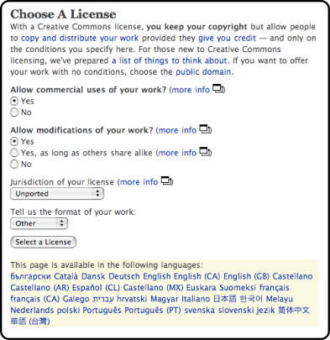
creative commons licences
Creative Commons licence chooser
http://creativecommons.org/license
Notes:
This button will take you to the CC licence chooser.
We understand that individuals are not necessarily going to know how to put these protocols together, so we developed a licence chooser on creativecommons.org that asks you a series of questions about how others can use the work. It also asks what medium the work is in and what country you are from. If you’re country doesn’t currently have CC licences, there is an ‘unported’ or ‘generic’ licence option.

Slide 18
creative commons licences
attribution
attribution–non-commerical
attribution–no derivatives
attribution–share alike
attribution–non-commerical–no derivatives
attribution–non-commerical–share alike
Notes:
Depending on how you answer, you can generate one of the following licences:
BY: is the most flexible licence, giving the reuser the right to share the work, remix the work or make money from the work or any adaptations thereof, so long as they acknowledge you as the creator
BY-NC: requires attribution + non-commercial reuse
BY-ND: requires attribution + verbatim reuse
BY-SA: requires attribution + down-stream remixing
BY-NC-ND: requires attribution, non-commercial reuse + verbatim reuse
BY-NC-SA: requires attribution, non-commercial use + down-stream remixing
Of course, the terms of the no derivative licence and the share alike licence are mutually exclusive.

Slide 19
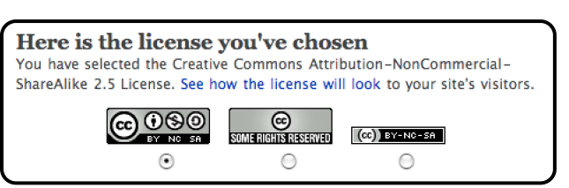
creative commons licences
licence notification badge
Notes:
When you’ve answered the questions in the generator you are presented with its associated notification badge. The version 3.0 licences saw the introduction of the small badge and a badge that includes the abbreviation of licence on the badge. In this instance an Attribution NonCommerical ShareAlike licence.
Simply choose which graphic you prefer.

Slide 20

creative commons licences
This work is licensed under a Creative Commons Attribution-NonCommerical-ShareAlike 2.5 Australia licence.
For full terms see http://creativecommons.org/licenses/by-nc-sa/2.5/au
copyright notice on your work
Notes:
When you have your licence, you need to tell people about it otherwise they will assume it is “all rights reserved.” This is an example of how you might give notice of your licence. The standard metadata for CC licences says, “This work,” however it is good to be specific in how you identify what is licenced so it is easy for others to know exactly what you are giving them rights to. It is important to include the URL because that directs people to information about what they can and can’t do with the work.
And on that, we understand that you aren’t lawyers and chances are neither will the people using your work so we include in the licence package what we call a Commons Deed.

Slide 21
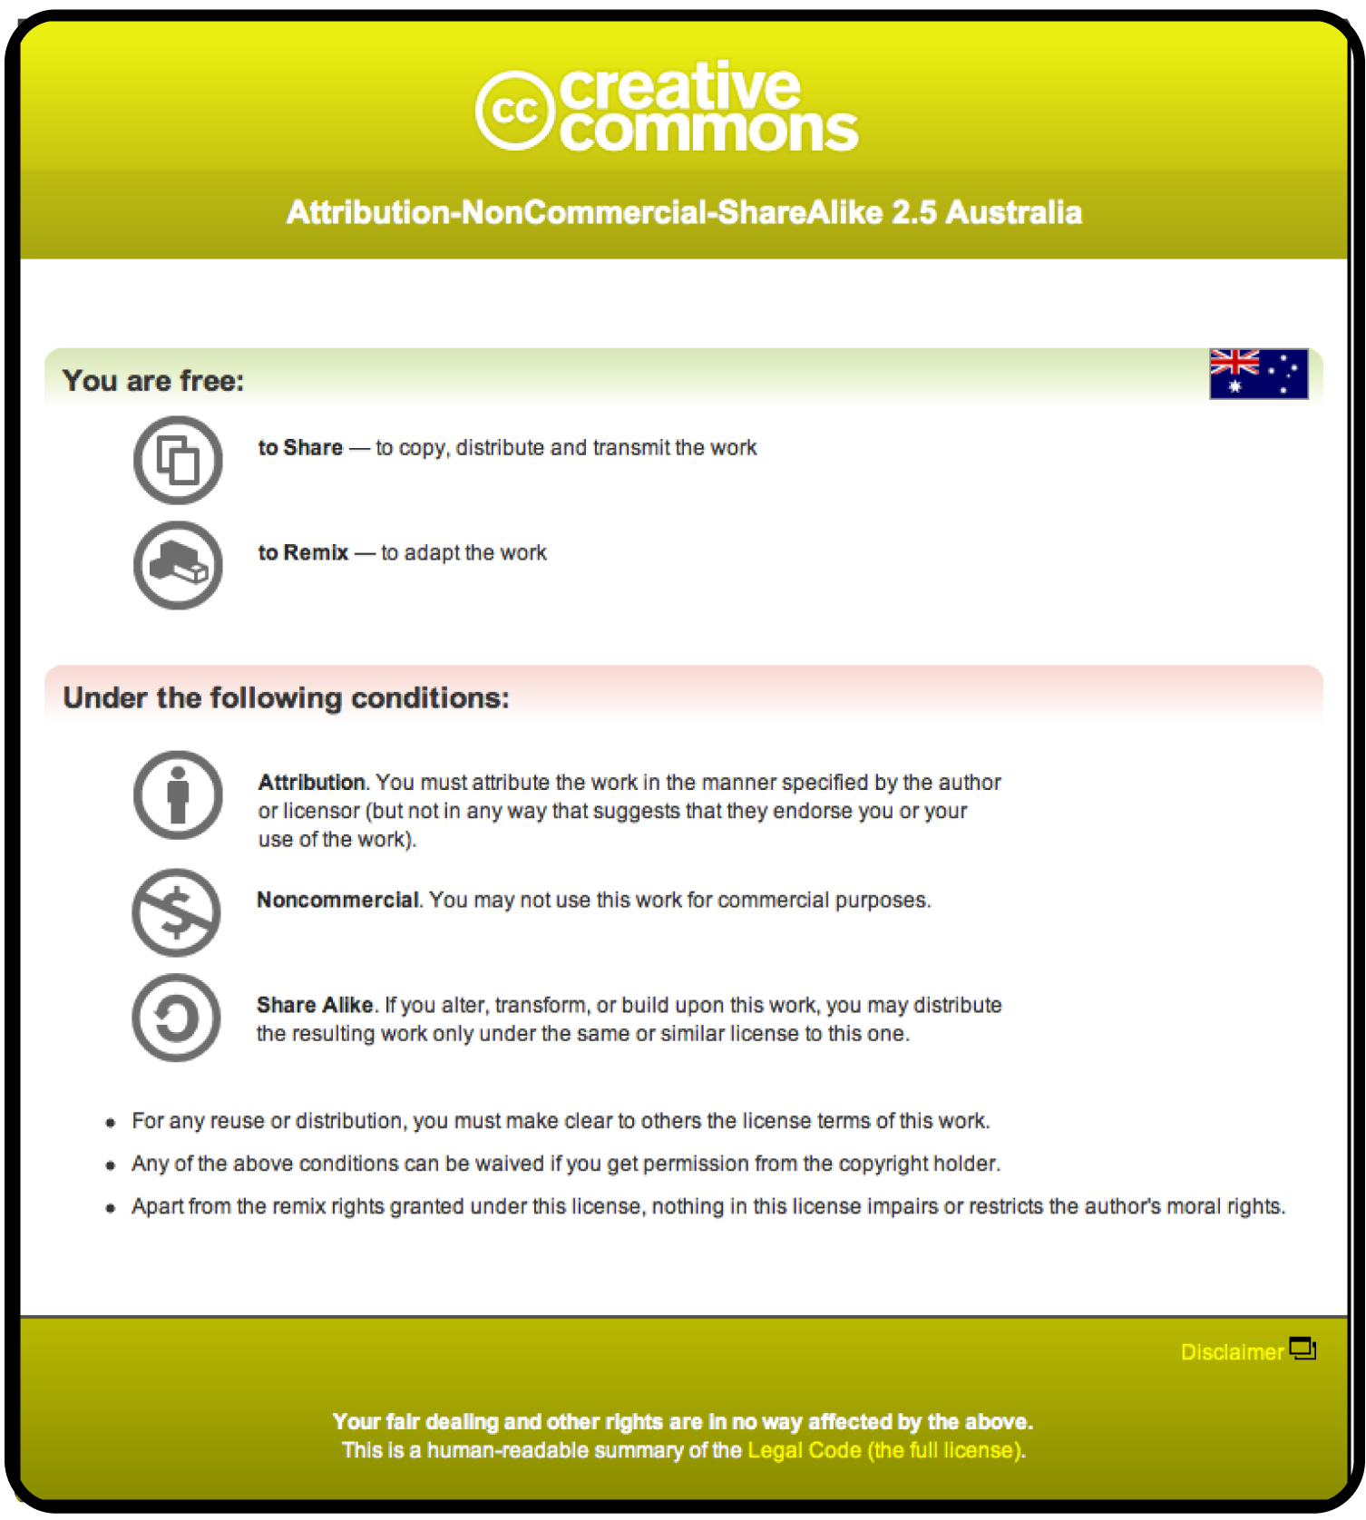
creative commons licences
commons deed (human-readable format)
Notes:
It’s a human-readable summary of what the licence permits.

Slide 22
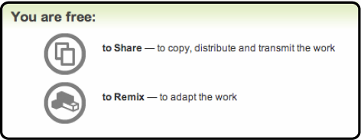
creative commons licences
outline of freedoms
Notes:
It outlines the freedoms granted under the licence. In this instance the freedom to share the work and to remix it.

Slide 23
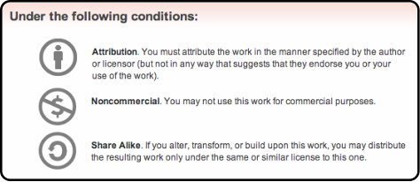
creative commons licences
outline of terms + conditions
Notes:
And it outlines the terms under which you can exercise those freedoms. This is were the information on the protocols is included.
The Deed summarises the Legal Licence.

Slide 24
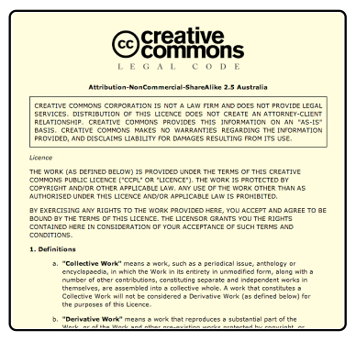
creative commons licences
legal licence (lawyer-readable format)
Notes:
The Legal Licence is the full legal document that underpins how you have decided to manage your licence.

Slide 25
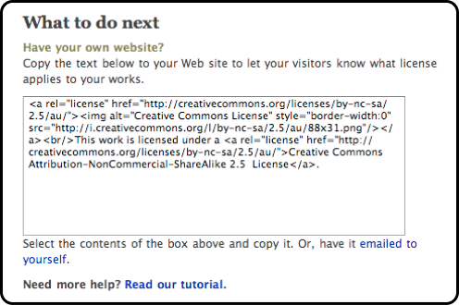
creative commons licences
technical code (machine-readable format)
Notes:
In addition to the Deed and Licence, Creative Commons also generates metadata or technical code which you can imbed in your file. This makes the licence information part of the file as well as making it readable by search engines and Web 2.0 applications.
But what does Creative Commons as a licensing model have to offer you as a documentary filmmaker?

Slide 26
creative commons + documentaries
possibilities for CC in documentary filmmaking:
viral distribution + promotion (online + offline);
a model for facilitating collaboration;
management of raw content; and
content for your film
Notes:
I see four main areas where CC can be useful to documentary:
as an alternative distribution model both online and offline;
as a way of managing or opening up your raw film content for others to use; and
as a way getting music, footage, sounds, photos and other forms of content for inclusion in your own film

Slide 27
cc as a distribution model
reasons you may want to give access to your work to:
encourage collaboration
increase reach and reputation
access new business models
gives new value to ‘back catalogue’ – eg BBC Creative Archive
gain community engagement or feedback – eg peer review
reduces costs for certain users - eg schools, libraries, charities
provide legal clarity and reduce administration costs
increase sum of human knowledge
encourage innovation
Notes:
There are a range of reasons why you may want other people to reuse your work.
for collaboration: encouraging extensions of your work or remixes
to increasing reach and reputation: you may be unsigned bands, or want to release previews of an upcoming film. CC lets you utilise the digital ‘word of mouth’
to access new business models such as ‘niche’ markets or advertising
to give new value to ‘back catalogue’, raw footage, abandoned works you’re not working on anymore: an example of this is the BBC Creative Archive which open content licensed large portions of archival material held by UK government creative institutions
to gain community engagement or feedback such as peer review processes
to reduce costs for certain users, for example using a non-commercial licence makes the content available to schools, libraries and non-profits
to provide legal clarity and reduce admin
to increase the sum of human knowledge and encourage innovation

Slide 28
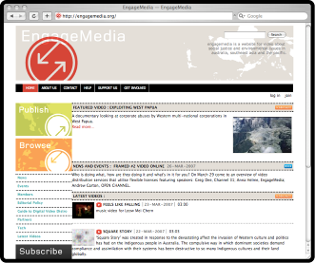
cc as a distribution model
giving access to your film
online video distribution platform for media about social justice and environmental issues in Australia, Southeast Asia and the Pacific
Anna Helme: “Many of these videos address concerns … largely ignored by other … distribution outlets”
“Creative Commons provides a very usable framework … [to] allow reproduction and distribution while preserving some rights…”
EngageMedia
http://engagemedia.org
source: Anna Helme, in conversation: EngageMedia, http://creativecommons.org.au/commoners/engagemedia
Notes:
Some films have see CC as the sole or primary way of distributing their film. EngageMedia for example is an online video distribution platform and community of filmmakers who produce media about social justice and environmental issues in Australia, Southeast Asia and the Pacific. One of the organisation’s Coordinators, Anna Helme, said “Many of these videos address concerns that are largely ignored by other funding and distribution outlets” She acknowledges the benefit of CC in helping provide access within prescribed terms to these films. “Creative Commons provides a very usable framework for filmmakers wishing to use open content licenses. They can allow reproduction and distribution while preserving some rights that leaves open the potential to recoup production funds through commercial distribution of their work.”
Essentailly EngageMedia has become a distribution and viewing point for these films, increasing visibility and audience, while not preventing future saleability and commercialisation of the films.

Slide 29
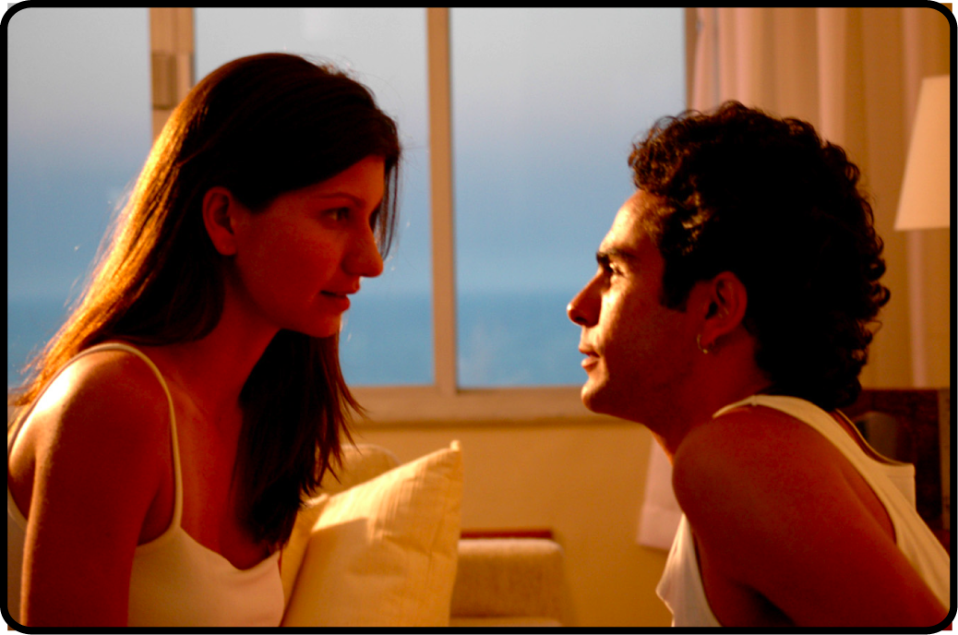
cc as a distribution model
giving access to your film
feature film funded by the Brazilian Ministry for Culture
Bruno Vianna: “Why should movies be restricted to a few cinemas…for a short period?”
licensed under CC BY-NC-SA Brazil 2.5
designed to:
  overcome bottlenecked cinema distribution in Brazil
  acknowledge its public funding; and
  value-add the film
Cafuné
www.cafuneofilme.com.br
Notes:
But what about where there is the possibility of the usual distribution outlet? Some films have see CC as another way of distributing their film in conjunction with traditional distribution mechanisms such as cinematic release. Cafuné for example was Brazilian director, Bruno Vianna’s first feature film. Bruno of his decision to simultaneously released in cinemas and online, “Why should movies be restricted to a few cinemas that can show the film only for a short period of time? Why shouldn’t we seek wider audience, exploring all possible means of distribution?” The online version being open to non-commercial remixing under the CC Attribution-NonCommerical-ShareAlike Brazilian licence._x0010_
Vianna’s decision to release the film under an open content licence was an attempt to overcome bottlenecked cinema distribution in Brazil where despite a growing number of locally produced flim being made, only about 50 make it into Brazilian movie theaters each year. The film was initially exhibited in five theatres in Rio de Janeiro and only one in São Paulo. Two weeks after the premi俊e, the number of cinema theatres it was shown in was reduced to a single theatre in Rio and the other in São Paulo. However, after another two weeks, it returned to three theatres in Rio de Janeiro! Because the licence allows public screenings, the film was also shown at cinema clubs, festival exhibitions, universities and schools, a much broader audience than theater-goers alone.
He also felt compelled to give it back to the public who had funded it. In interview he said, “It doesn’t make sense to not make a work that is supported by public investment widely available.”
The remixability of the film he saw as a value-add and interest generator in the flim. He was keen to see how other people would reuse the film.
And of course, despite anyone being able to burn it to DVD themselves, Vianna will still release the film as a DVD. He believes that the exclusive value-added content such as the making of the movie clip, commentary on the film and other bonus features, are appealing to those who buy the DVD.

Slide 30
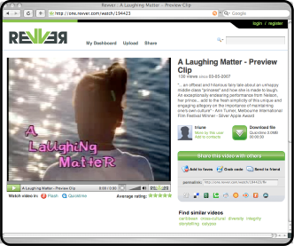
cc as a distribution model
licensing previews, trailers and excerpts
released a 30 second trailer on Revver under a Creative Commons BY-NC-SA 2.0 licence
winner of Silver Apple Award at the National Educational Film and Video Festival
shown at Melbourne International Film Festival, Chicago International Festival of Children’s Films, International Children's Film and Video Festival
broadcast by the South African Broadcasting Corporation
A Laughing Matter
Notes:
But don’t think that you have to put out the whole film up for anyone to reuse and cut up.
One way filmmakers are using CC is licensing previews, trailers and excerpts. On film that did this was A Laughing Matter, a 28 minute modern-day comedy fairy tale about an unhappy middle class "princess" and how she is made to laugh. The film released its trailer on Revver which uses the Creative Commons Attribution-NonComemercial-NoDerivatives licence.
The film won the Silver Apple Award at the National Educational Film and Video Festival held in Oakland, California and has been showed at numerous festivals world-wide. More recently it was broadcast by the South African Broadcasting Corporation.

Slide 31

cc as a collaboration model
opening up the creative process to other parties
1000 people to donate £25 each
collaborative input into The Unfold and Glitch
both films licensed under a CC BY-NC-SA 2.5 and CC Sampling +
the films are:
  peer-to-peer friendly
  remix ready
  no digital rights management
released trailers under CC BY-NC-ND 2.5 on blip.tv, http://aswarmofangels.blip.tv
A Swarm of Angels
www.aswarmofangels.com
Notes:
Another interesting and innovative way of using CC licences in filmmaking is the A Swarm of Angles remixable film project. The project is calling for 1000 people to donate £25 each. For your donation you can have input into the script and development of two films, The Unfold and Glitch, both of which will be licenced under an Attribution-Noncommerical-ShareAlike licence. They will also be licenced under a Sampling Plus licence which will allow sampling for commercial or non-commercial purposes. As such the films are peer-to-peer friendly, rexmix ready and playable on anything because they don’t include digital rights management.
The project has also released trailers for the film on blip.tv under an Attribution-Noncommerical-NoDerivatives licence. You can find them at aswarmofangels.blip.tv

Slide 32
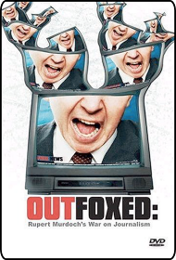
managing raw material
documentary film
original footage (including interviews) released under a CC Sampling +
Robert Greenwald: “I learned how cumbersome and expensive it can be to licence footage…”
“Creative commons licenses allow me as a filmmaker to know immediately how I can used a piece of content”
Outfoxed
Notes:
It is great in theory to give away your trailers and/or your film, but when you’re dealing with third parties who have vested interest in your film, that can get tricky. But that doesn’t stop you from using CC altogether. Another way to use CC for your film is to release footage you didn’t use in the final cut.
Original footage from Robert Greenwald‘s 2004 documentary Outfoxed: Rupert Murdoch's War on Journalism was released under a Creative Commons Sampling Plus licence. Why? In interview Greenwald said, “In making Outfoxed and Uncovered, I learned how cumbersome and expensive it can be to license footage from news organizations. Creative Commons licenses allow me as a filmmaker to know immediately how I can use a piece of content in my films.” He went on to say, “I could think of no better way to walk the talk myself than by releasing the interviews from Outfoxed and Uncovered under a license that allows other filmmakers to use my material in new and creative ways.”
If you own footage that you may never use again but other people could make use of it, what is really stopping you form giving other people the right to use it? Even if you licence it under a Creative Commons licence doesn’t mean you can’t still use it.

Slide 33
creative commons as a resource
creative commons licenced material is:
a pool of material;
legally available for reuse;
without additional permission;
(generally) without payment;
under certain conditions.
of course, you can individually licence for other uses
Notes:
On the flip side, it’s not all give, give, give. There is an growing pool of content that is under CC licence that is available for you to use. At last count there was over 140 million link-backs to CC licences, and how knows how many not linked back or in physical formats?! Everything from footage, photos, music and research to weblogs and software.
These licenced works are part of a pool of material that is legally available for reuse by you in your own creative endeavours. Because they are under a CC licence you require no additional permission to use them, don’t have to pay for them (in most circumstances) as long as you don’t do anything that licence doesn’t let you do.
Of course, if what you want to do isn’t covered by the licence, you can get in contact with the copyright owner and request a licence for that use.

Slide 34

finding creative commons content
Creative Commons find button
http://creativecommons.org
Notes:
So if there is all this stuff out there, how do you find it?
the first port of call we recommend is the Creative Commons search page which you can access via the ‘Find CC Licensed Work’ button at the top of the Creative Commons homepage.

Slide 35
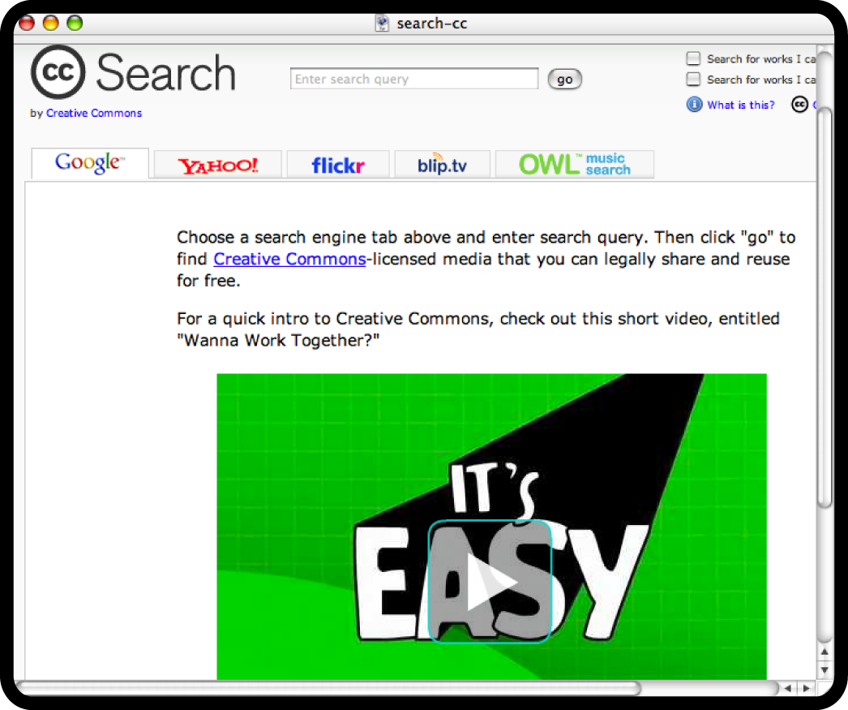
finding creative commons content
creative commons search page
http://search.creativecommons.org
Notes:
It’s a human-readable summary of what the licence permits.

Slide 36

finding creative commons content
creative commons search page
http://search.creativecommons.org
Notes:
This provides you with a tabbed search engine with access to the CC search on Google, Yahoo, Flickr, blip.tv and OWL music

Slide 37








cc as a resource
film + video
www.revver.com
www.archive.org
www.channel4.com/interact
photos
www.openphoto.net
www.flickr.com/creativecommons
music
www.ccmixter.org
www.opsound.org
www.magnatune.com
Notes:
There is also a range of third party sites that host Creative Commons licenced content. Aggregator sites for film and video, photos and music may be useful.

Slide 38


use of creative commons content
Children of Men used CC sound
from the Freesound Project
first major motion film to use CC content
nominated for three Academy Awards
Children of Men
source: male_Thijs_loud_scream by thanvannispen, under a CC Sampling + licence, http://freesound.iau.upf.edu/samplesViewSingle.php?id=9432
Notes:
And if you don’t think anyone in the film industry is using it you’re wrong. Children of Men, directed by Alfonso Cuarón, used a Creative Commons licensed sound from Freesound, a repository of CC licenced sounds. The film used this sound. Here you can see where the sound is attributed in the credits at the end of the film.
It is believed to be the first major motion picture which uses Creative Commons licensed content. And it was nominated for three Academy Award in 2007.

Slide 39
about creative commons
CC licences are not:
anti-copyright
anti-commercial
right for every situation
Notes:
Before I finish up, there are a few things to remember when using Creative Commons licences. Firstly, CC is not anti-copyright, it is simply another way of managing your copyright. They rely on copyright for enforceability.
CC is not anti-commercial, we want filmmakers to get paid for their work. Use the noncommercial protocol if you don’t want others making money on your work. That way you can on-sell the commerical rights to the film. Equally, you can commercialise in other ways. By selling the first use and then CC licensing subsequent uses. Or by providing add ins or value adds in sold versions. Or by selling associated merchandise. It’s time people started to think a little more creatively about how to make money doing what you love.
Thirdly, CC is not right for every situation. You may not have all the rights to release the work in the first place or there may be other vested interests which limit your ability to open licence. Equally, for some works it just may not be adventageous to open licence. Be sure CC is right for what you want to do.

Slide 40
contacting elliott
feel free to get in touch with me:
  elliott bledsoe
  project officer
  creative commons australia
  +61 7 3138 9597
  0433328462
  elliott@creativecommons.org.au
  http://creativecommons.org.au
presentation + additional resources available at
http://creativecommons.org.au/aidc
Notes:
Thank you for the invitation to speak today. I hope I have given you all an insight into new ways of managing copyright. There will be questions now or you can hit me up if you see me around for the rest of the conference.
You can download this presentation and additional resources at creativecommons.org.au/aidc within a week.

